Slide 1

Hangul Characters Classification by Quantum Machine Learning
Members : Junghan Lee, Jinsung Bae
Mentors : Kifumi Numata, Dayeong Kang, Anna Phan

Slide 2

Motivation
Classifying Hangul characters using quantum computer
No QML work on Hangul characters yet
Expecting more attention from Korean quantum community

Slide 3
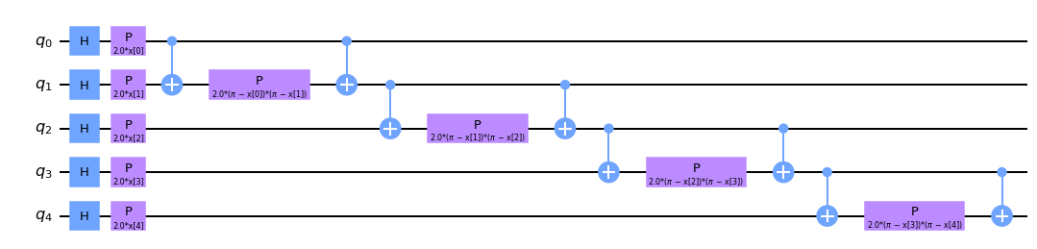
Approach
QSVM (Quantum Support Vector Machine)
Make our own dataset

Slide 4
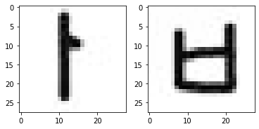
Code1 : Separate Characters

Slide 5
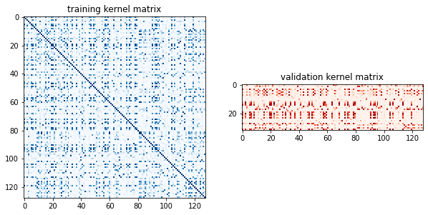
Code1 : Separate Characters

Slide 6
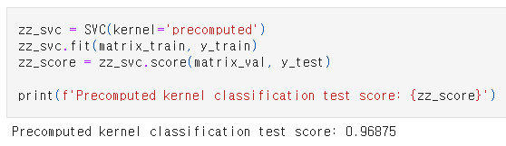
Code1 : Separate Characters

Slide 7
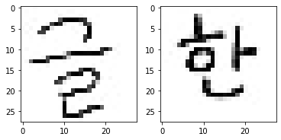
Code2 : Combined Characters

Slide 8
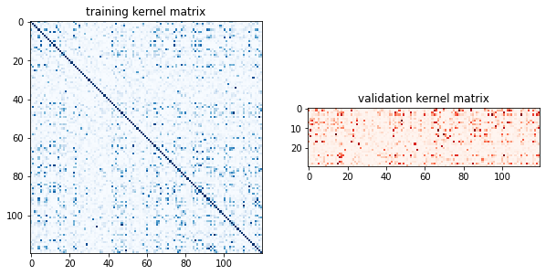
Code2 : Combined Characters

Slide 9
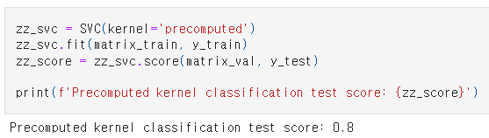
Code2 : Combined Characters

Slide 10
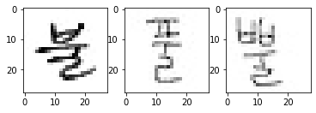
Code3 : Similar characters

Slide 11
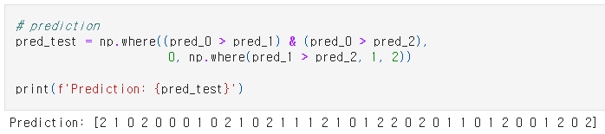
Code3 : Similar characters

Slide 12
Improvements
Better Hangul datasets
Algorithm that can deal with more characters.

Slide 13
Thank You
Issue #5

